Slide 1
Lecture course.
Electronic structure of topological insulators and superconductors
Part 2: Superconductivity in topologically nontrivial systems
A. S. Mel’nikov
Institute for Physics of Microstructures RAS
Nizhny Novgorod, Russia

Slide 2
Our goal: to develop simple analogy
Insulating gap
superconducting gap
Edge or surface states
Subgap quasiparticle states
Q: is it possible?
Some difficulties:
Can the supercurrent spoil all the fun?
How to get nontrivial gap dependence in k-space?
Different nature of quasiparticle confinement?

Slide 3
Outline
Confinement of excitations in superconducting state
Bogolubov-de Gennes theory, Andreev reflection,
Andreev wells etc
Unconventional superfluids with nontrivial topology
gap anisotropy, singlet and triplet Cooper pairs
Induced superconducting order
Semiconducting wires with induced superconductivity. Superconductivity at the surfaces.
Majorana states.
  Bogolubov transformation etc. Andreev reflection. Topological protection and nonlocality. Braiding.

Slide 4
Electrons and holes in normal metal
holes
electrons
Fermi liquid effects:
Shroedinger equation:

Slide 5
Electrons and holes in superconductors
- Amplitude of scattering of electron from the state to the state
Electrons and holes in superconductors.
Anomalous averages
- Amplitude of scattering of electron from the state to the hole state
2 coupled Shroedinger equations= Bogolubov-de Gennes equaitons

Slide 6
Homogeneous superconducting state:
Superconducting gap

Slide 7
Some useful details:
Magnetic field, order parameter phase, gauge invariance, elastic scattering, spin

Slide 8
More useful details:
What is the operator ?
Answer 1: it is the order parameter in the Ginzburg-Landau theory
Answer 2: it is the self-consistent field of Cooper pairs
Answer 3: it is the nonlocal gap operator

Slide 9
Methods of solution
The scale of the gap modulation
Quasiclassical approach:

Slide 10
Peculiarities of the quasiclassical approach in BdG equations

Slide 11
Peculiarities of the quasiclassical approach in BdG equations

Slide 12
Peculiarities of the quasiclassical approach in BdG equations

Slide 13
Peculiarities of the quasiclassical approach in BdG equations

Slide 14
Peculiarities of the quasiclassical approach in BdG equations

Slide 15
Quasiclassical approach. Andreev equations

Slide 16
Analogy to the case of topological insulators
Q: How to get an appropriate ?

Slide 17
Andreev reflection
Reflected electron
Incident electron
Reflected hole
Normal metal
barrier
superconductor
supercurrent
Heat transport. SNSNS structures – intermediate state (A.F.Andreev)

Slide 18
Andreev bound states
S
N
S
e
2e
h
d
x

Slide 19
Examples:
Josephson junction
vortex
Anomalous spectral branch.
Bound quasiparticle states
Fermi level
minigap

Slide 20
General recipe how to arrange zero energy states (at the Fermi level).
Compare: Volkov-Pankratov problem
superconducting phase should change by pi
energy=0

Slide 21

Hallmark of the bound states at the Fermi level.
Resonant Andreev reflection. Zero-bias anomaly.

Slide 22
We need the gap function which changes its sign with the change in the momentum

Slide 23
Q: Do we have some way to modulate the gap in the k-space (!?)
Unconventional superconductors
Self-consistency condition.
Internal momentum
Ginzburg-Landau variable

Slide 24
Q: Do we have some way to modulate the gap in the k-space (!?)
Unconventional superconductors
Self-consistency condition.
Singlet pairing
Triplet pairing

Slide 25
P-wave superconductors. Sr₂RuO₄ as a possible candidate?
He-3
Edge states
Free vortex
Fermi level

Slide 26
Sample edge
1D P-wave superconductor
Vacuum or insulator

Slide 27
Another possibility to get topologically nontrivial systems:
Creating the systems with induced superconducting order to engineer the properties of new
superconducting materials

Slide 28
Systems with induced superconducting order
Topological insulators
Graphene nanoribbons
nanowires
X.-L. Qi, S.-C. Zhang,
RMP 83, 1057 (2011).
A. H. Castro Neto, et al.,
RMP 81, 109 (2009)
J.-C. Charlier, X. Blase, S. Roche,
RMP 79, 677 (2007).

Slide 29

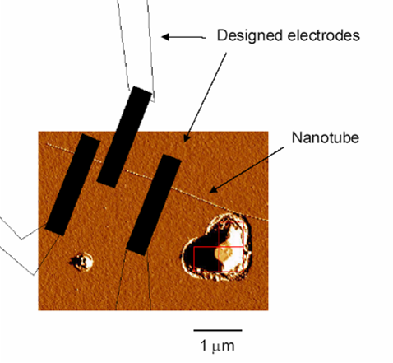
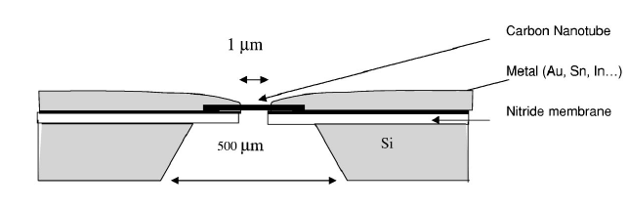
Nanowires with superconducting electrodes
Carbon nanotube -Ti/Al electrodes
InAs semiconductor nanowire-Ti/Al electrodes
Doh et al., Science 309, 272 (2005)
Jarillo-Herrero et al., Nature 439, 953 (2006)
A. Kasumov et al, PRB 68, 214521 (2003)

Slide 30
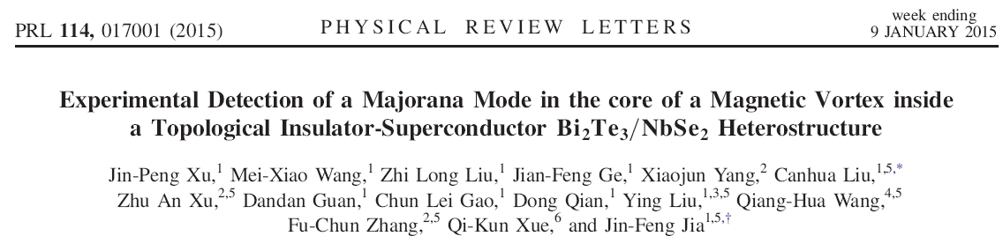
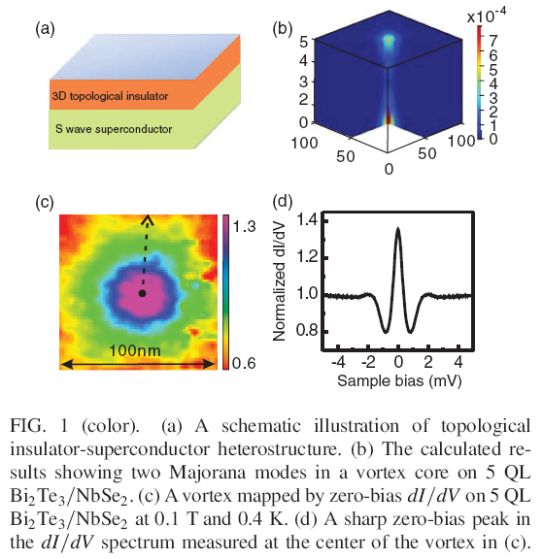
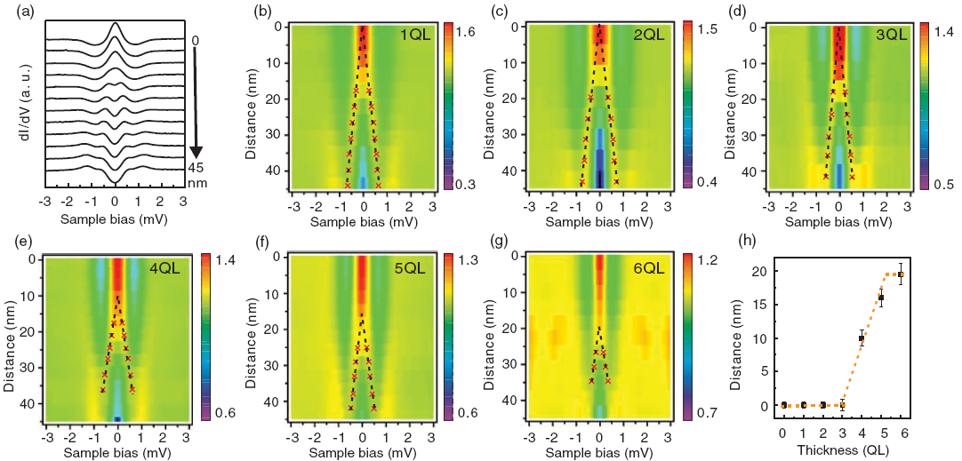
Search for nontrivial superconductivity

Slide 31
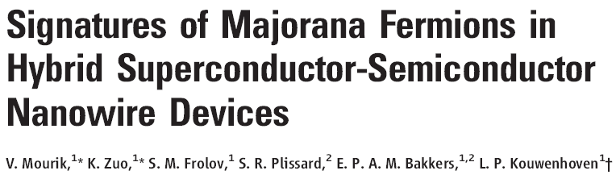
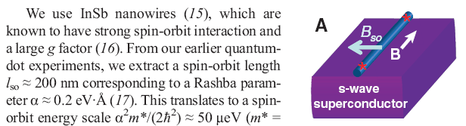
Systems with induced superconducting order
Search for localized states

Slide 32
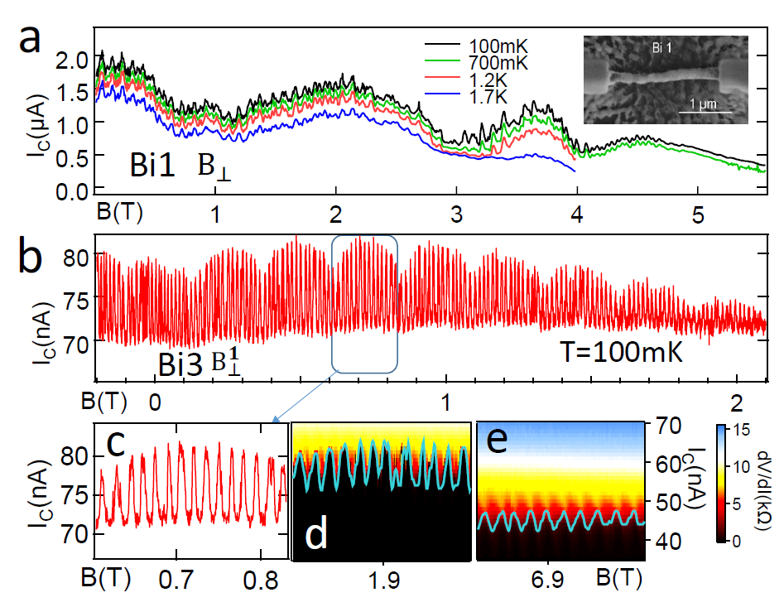
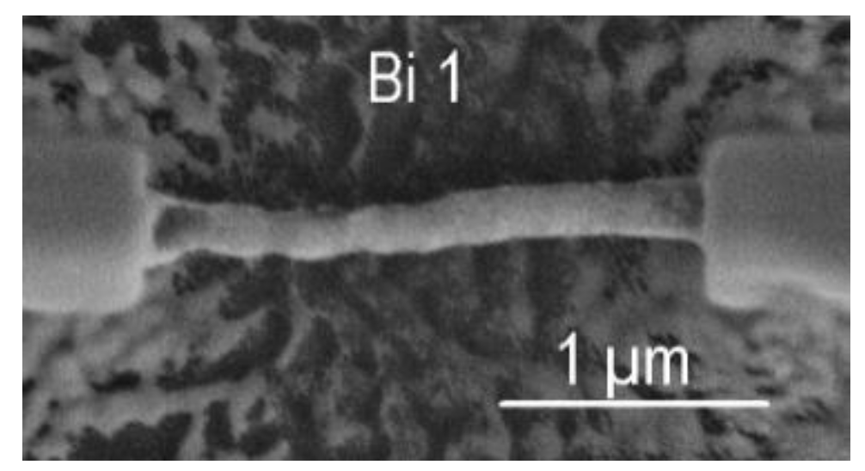
Josephson transport through a Bi nanowire
Multiperiodic magnetic oscillations
C. Li, A. Kasumov, A. Murani, S. Sengupta, F. Fortuna, K. Napolskii, D. Koshkodaev, G. Tsirlina, Y. Kasumov, I. Khodos, R. Deblock, M. Ferrier, S. Guéron, H. Bouchiat, arXiv: 1406.4280 (2014)

Slide 33
Task for theoreticians:
Develop an approach describing inhomogeneous superconducting states in systems with superconducting ordering induced by proximity effect
Possible ways:
To introduce a phenomenological gap into microscopic equations.
more or less microscopic approaches based on calculations of the induced gap.
a. Tight-binding approximation.
b. Continuous models using model assumptions about the tunneling between the bulk superconductor and low-dimensional system.

Slide 34
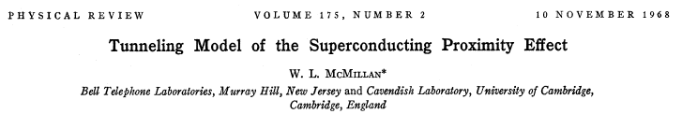
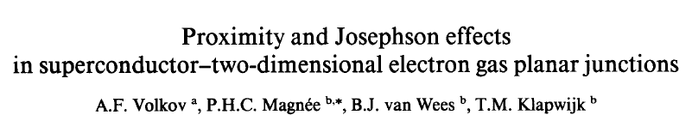
Thin film of normal metal
Isolating barrier
superconductor

Slide 35
Induced superconducting gap
2D layer
superconductor

Slide 36


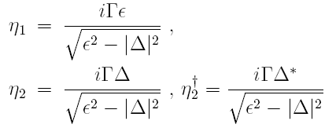
Microscopic model.
Derivation.
Homogeneous state:

Slide 37
S2D-N2D junction. Andreev reflection. Two gaps.
Incident electron
Reflected hole

Slide 38

S2D-N2D junction. Differential conductance.
States above the effective gap: Tomash oscillations

Slide 39

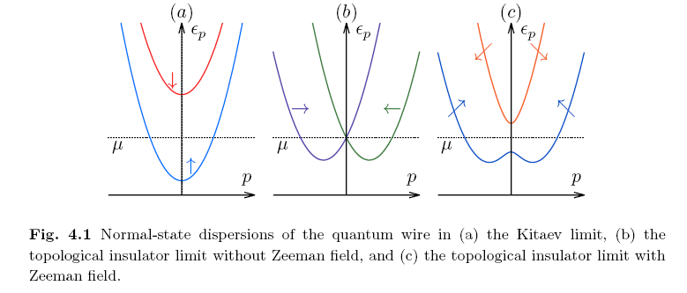



Nanowires in magnetic field and strong spin-orbit interaction

Slide 40
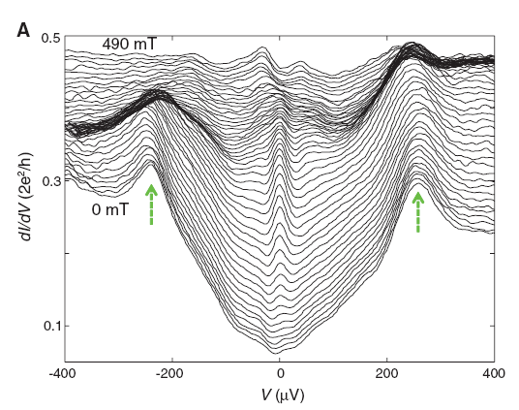
Zero bias anomaly !?

Slide 41
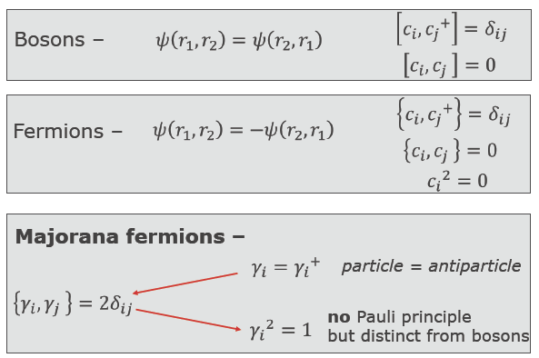
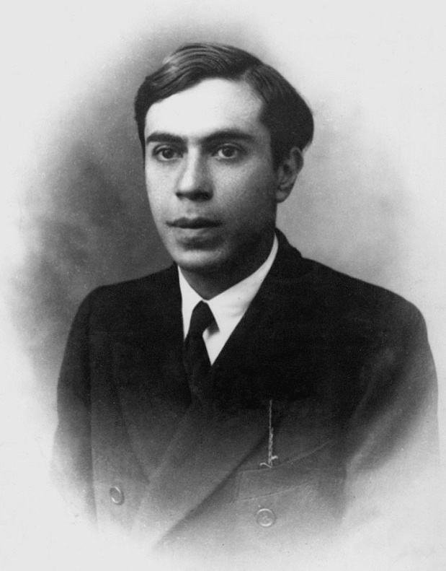
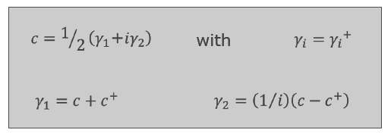
Ettore Majorana 1906-?

Slide 42
BCS mean field theory.
Bogolubov canonical transformation.
No changes in the operator commutation rules
Annihilation and creation electron operators
Annihilation and creation quasiparticle operators
Inverse transformation

Slide 43
Fermi commutation rules:
Orthogonality condition:
Complete set of functions:

Slide 44

Bogolubov – de Gennes equations and their symmetry
All states come in pairs???

Slide 45
Singlet pairing
Triplet pairing

Slide 46
Is it possible to get a state without a partner?
Majorana state
Standard fermions (with usual commutation rules)
???? Majorana fermions (not fermions at all)
Obvious contradiction:
We can not change statistics using canonical Bogolubov tranformation

Slide 47
Partly defined quasiparticle
How to define this b-part???
Possible answer: Let us find another ill-defined quasiparticle!

Slide 48
A standard way to overcome the problem:
We construct the operator b from another zero energy state
The states which define a and b are far away from each other
Examples:
vortices in p-wave superconductors (G.E.Volovik, 1997)
Edge states (Kitaev 1D p-wave superconductor)
Systems with induced superconductivity

Slide 49

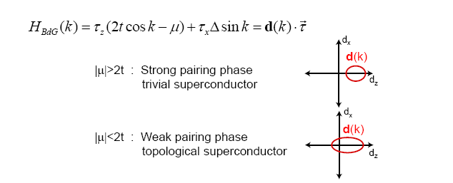
Examples of Majorana states. Kitaev chain.
Topologically trivial phase
Topologically nontrivial phase
Edge states

Slide 50
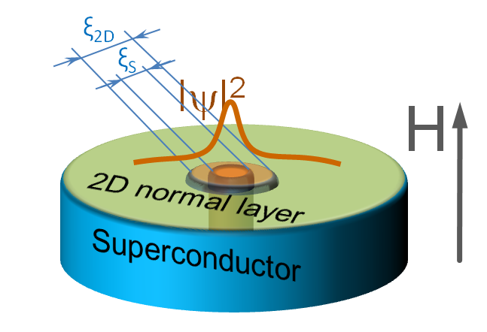
Examples of Majorana states.
InAs (InSb) wire with induced superconductivity
Edge states
Vortex in 3D topological insulator coupled to superconductor with a hole

Slide 51


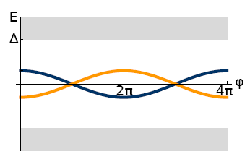

Josephson systems with Majorana states.
Bound quasiparticle states
or periodicity of Josephson current?

Slide 52
Idea of manipulation and braiding of Majorana states
Standard quantum mechanics: or
Q: Can be an arbitrary phase factor, or operator?
Related Q: How does an ensemble of Majorana particles arrange in pairs?
Degenerate ground state?

Slide 53
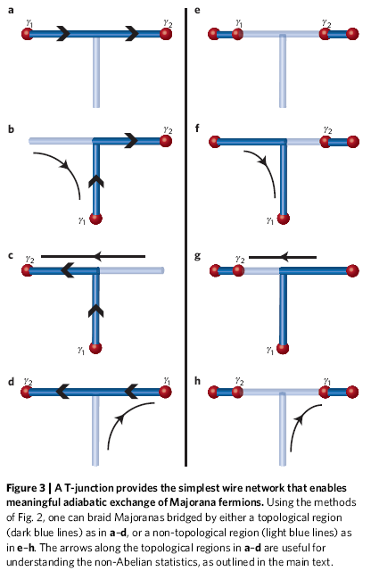
Braiding in nanowires by gates
Braiding in vortex arrays
Q: Dissipation???

Slide 54

Some conclusions
topologically nontrivial states can be creating in superconductors with non s-wave pairing
one can engineer the effective pairing in hybrids
new physics of manipulation of Majorana states
Some references

Slide 55
Some problems to be solved after lectures
Solve the Volkov-Pankratov problem (find localized states at the interface with the band inversion) for the particular case of the step-like profile
Solve the Andreev equation (find the subgap localized state) in the step-like gap profile.
2a. Find the localized subgap state at the end of a superconducting wire with p-wave pairing
3. Solve them and send to
melnikov@ipmras.ru

